Slide 1
Murach’s C# (8th Edition)
Chapter 16
How to organize, document, and test your classes

Slide 2
Objectives
Applied
Add XML documentation to your classes.
Create and use a class library.
Use unit testing to test your classes and class libraries.
Knowledge
Describe two ways that you can code two or more classes in a single file.
Describe the use of partial classes.
Describe the use of namespaces.
Describe the difference between file scoped and block scoped namespaces.

Slide 3
Objectives (continued)
Describe the benefits of creating and using a class library.
Describe the advantages of unit testing.
Describe the AAA pattern that’s commonly used with unit testing.

Slide 4
A file with two classes coded one after the other
public class Class1
{
// Body of Class1
}
public class Class2
{
// Body of Class2
}

Slide 5
A file with nested classes
public class OuterClass
{
InnerClass ic = new InnerClass();
// code that uses the inner class
// Body of OuterClass
public class InnerClass
{
// Body of InnerClass
}
}
Code that refers to the nested class from another class
OuterClass.InnerClass inner = new();

Slide 6
A Customer class that’s split into two files
The first file
public partial class Customer
{
// Some members of the Customer class
}
The second file
public partial class Customer
{
// The rest of the members of the Customer class
}

Slide 7
A Form class that’s split into two files
The Form1.cs file
public partial class Form1 : Form
{
// The code for the Form1 class that's added
// by the programmer
}
The Form1.designer.cs file
partial class Form1
{
// The code for the Form1 class that's generated
// by Visual Studio
}

Slide 8
Code that declares a namespace
namespace ProductMaintenance
{
public partial class Form1 : Form
{
// Body of Form1 class
}
}

Slide 9
Code that declares nested namespaces
namespace Murach
{
namespace Validation
{
// Body of Validation namespace
}
}
Another way to nest namespaces
namespace Murach.Validation
{
// Body of Validation namespace
}

Slide 10
A using directive that specifies a namespace
using Murach.Validation;

Slide 11
Code that declares a file scoped namespace
namespace ProductMaintenance;
public partial class Form1 : Form
{
// Body of Form1 class
}

Slide 12
Code that declares nested file scoped namespaces
namespace Murach.Validation;
// Body of Validation namespace

Slide 13
Rules for file scoped namespaces
Each file can declare only one file scoped namespace.
Only using directives can precede the declaration of a file scoped namespace in a file.
A file cannot declare both a file scoped namespace and block scoped namespaces.

Slide 14
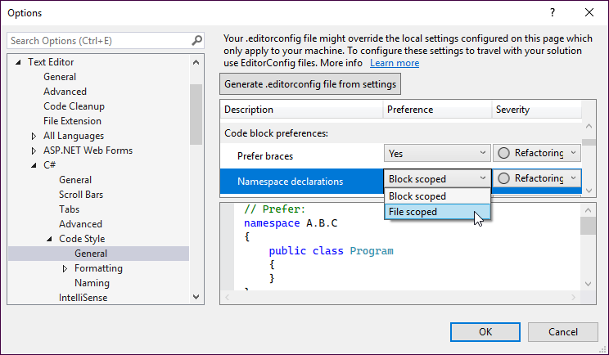
The Options dialog for configuring Visual Studio to generate file scoped namespaces

Slide 15
Part of a Validator class with XML documentation (part 1)
/// <summary>
/// Provides static methods for validating data.
/// </summary>
public static class Validator
{
/// <summary>
/// The character sequence to terminate each line
/// in the validation message.
/// </summary>
public static string LineEnd { get; set; } = "\n";
/// <summary>
/// Checks whether the user entered a value.
/// </summary>

Slide 16
Part of a Validator class with XML documentation (part 2)
/// <param name="value">The value to be validated.
/// </param>
/// <param name="name">A name for the value.</param>
/// <returns>An error message if no value entered
/// </returns>
public static string IsPresent(
string value, string name)
{
string msg = "";
if (value == "")
{
msg = $"{name} is a required field.{LineEnd}";
}
return msg;
}
...
}

Slide 17
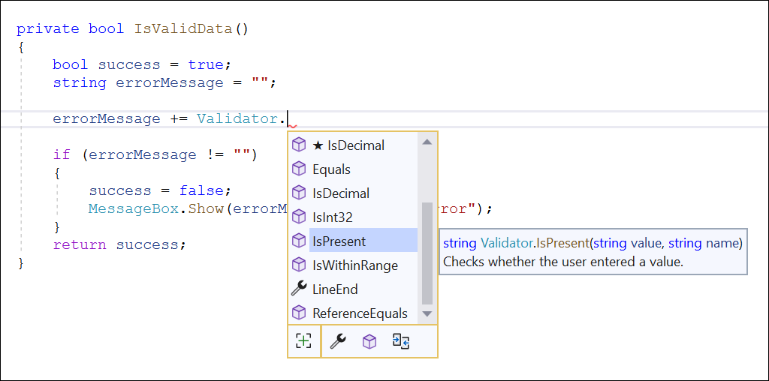
A screen tip with documentation for a method

Slide 18
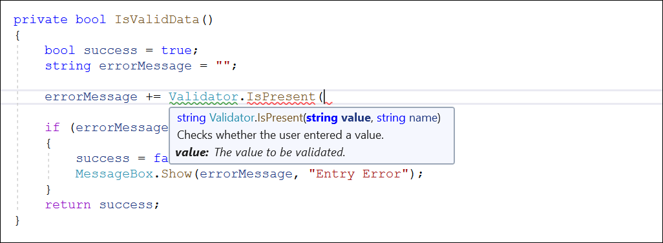
A screen tip with documentation for a parameter

Slide 19
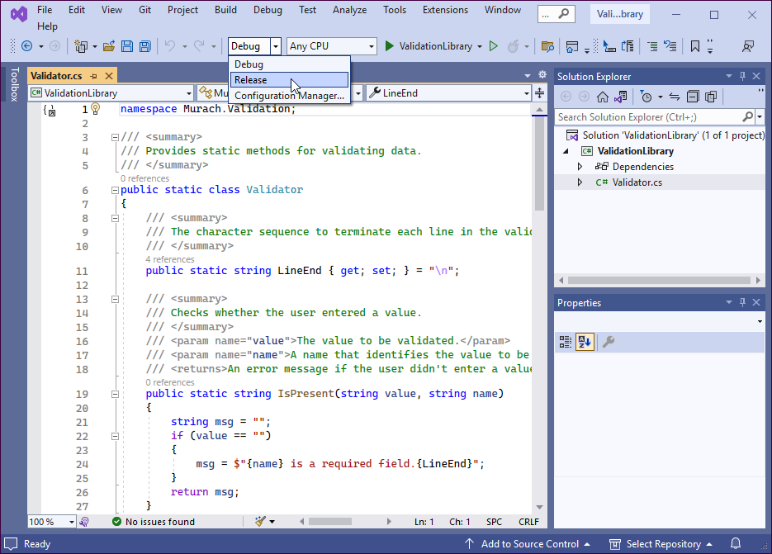
A class library project

Slide 20
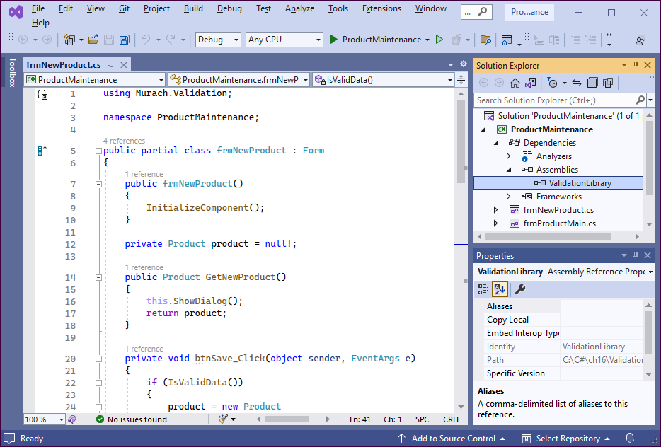
A project with a reference to a class library

Slide 21
A using directive for the validation class library
using Murach.Validation;

Slide 22
The unit testing process
Code test methods to call methods of other classes
Execute test methods to verify that the code works correctly.
Debug and fix code that causes the test methods to fail.

Slide 23
The benefits of unit testing
Unit testing helps you find problems earlier in the development cycle.
You can run the unit tests for a class each time you change it to detect any problems that were introduced.
You can develop and test an app more quickly because you can test just the code that was changed without running the full app.
Debugging is easier because when a test fails, you only need to debug the most recent code changes.

Slide 24
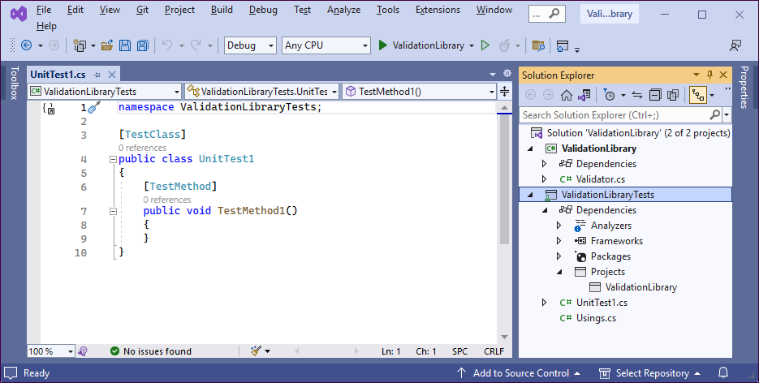
A Visual Studio solution with a unit test project

Slide 25
How to add a unit test project to a solution
Right-click on the solution in the Solution Explorer and select Add→New Project to display the Create a New Project dialog.
Select the MSTest Test Project template, and click the Next button to display the Configure Your New Project dialog.
Enter a name for the project. The location will default to the folder for the current solution, which is usually what you want.
Click the Next button, select a framework from the Additional Information dialog, and click the Create button.

Slide 26
Common static methods of the Assert class
AreEqual(expected, actual)
AreNotEqual(expected, actual)
IsFalse(booleanExpression)
IsTrue(booleanExpression)

Slide 27
The Usings.cs file
global using Microsoft.VisualStudio.TestTools.UnitTesting;
global using Murach.Validation;

Slide 28
Unit tests for the Validator class
[TestClass]
public class ValidatorTests
{
[TestMethod]
public void IsDecimal_ValidValueReturnsEmptyString()
{
string expected = "";
var result = Validator.IsDecimal("3.14", "Name");
Assert.AreEqual(expected, result);
}
[TestMethod]
public void IsDecimal_InvalidValueContainsFieldName()
{
string name = "Test field"; // arrange
var result = Validator.IsDecimal("three", name);
// act
Assert.IsTrue(result.Contains(name)); // assert
}
...
}

Slide 29
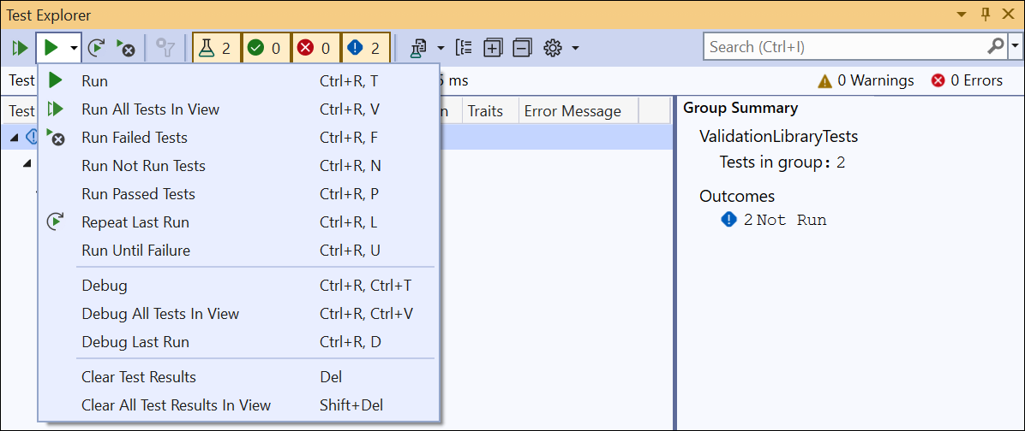
The Test Explorer window before the tests are run

Slide 30
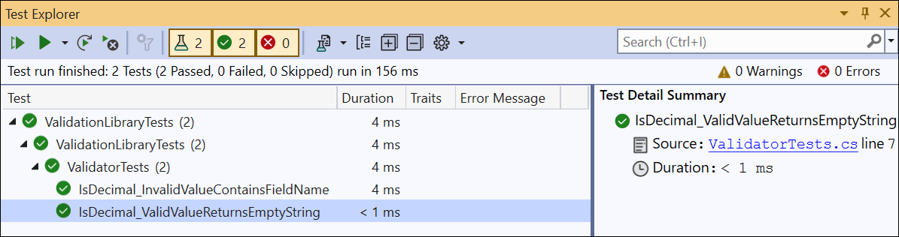
The Test Explorer window with the results of a test run

